Slide 2
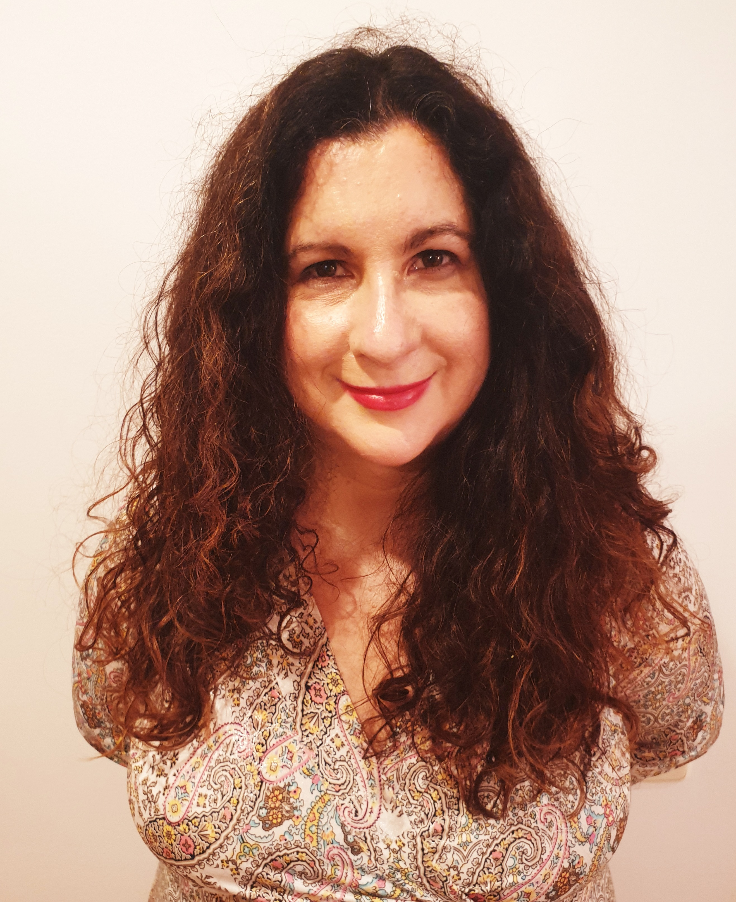
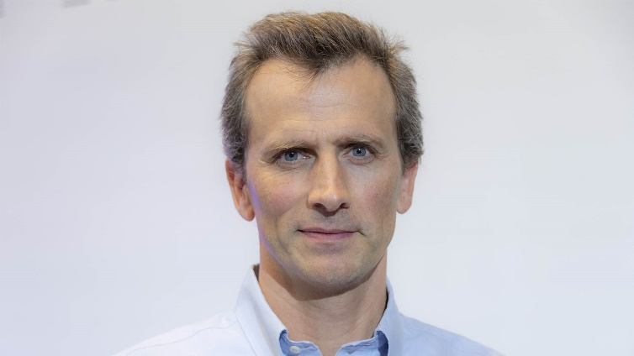
GSI'23 keynote speakers
Francis Bach
INRIA, France
Diara Fall
Orleans University, France
https://sites.google.com/site/mdiarrafall
Eva Miranda
UPC AND CRM-BARCELONA, spain
https://web.mat.upc.edu/eva.miranda/nova/

Slide 3
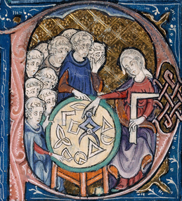
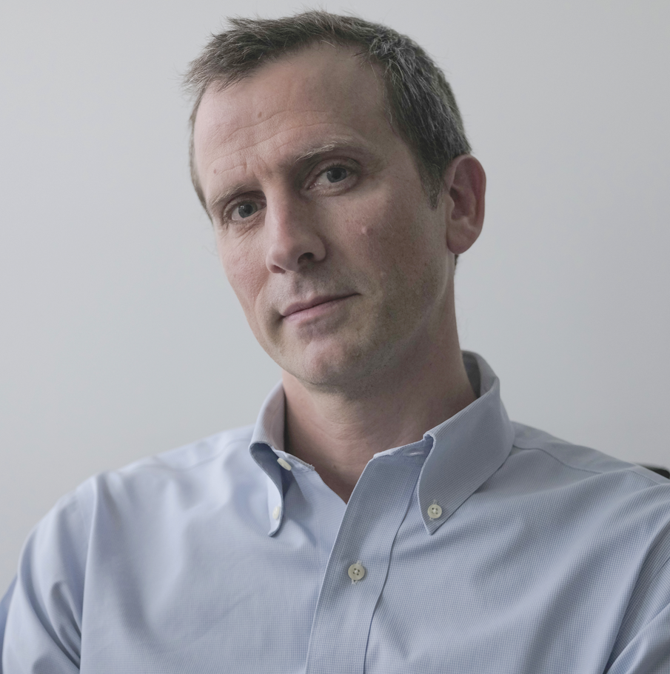
Geometric Science of Information (GSI'23) Saint-Malo, France, 30th Aug-1st Sept 2023 Keynote speaker: Francis BACH
Information Theory with Kernel Methods
Estimating and computing entropies of probability distributions are key computational tasks throughout data science. In many situations, the underlying distributions are only known through the expectation of some feature vectors, which has led to a series of works within kernel methods. In this talk, I will explore the particular situation where the feature vector is a rank-one positive definite matrix, and show how the associated expectations (a covariance matrix) can be used with information divergences from quantum information theory to draw direct links with the classical notions of Shannon entropies.
IEEE Transactions in Information Theory 2022. arXiv:2202.08545
https://gsi2023.org/
Inria
Ecole Normale Supérieure
1/n

Slide 4
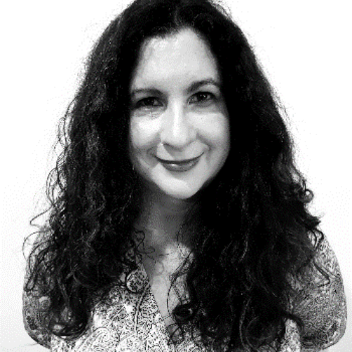
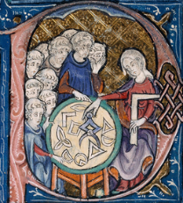
Geometric Science of Information (GSI'23) Saint-Malo, France, 30th Aug-1st Sept 2023 Keynote speaker: Eva MIRANDA
Polytechnic University of Catalonia
From Alan Turing to Contact geometry: towards a "Fluid computer”
Is hydrodynamics capable of performing computations? (Moore 1991). Can a mechanical system (including a fluid flow) simulate a universal Turing machine? (Tao, 2016). Etnyre and Ghrist unveiled a mirror between contact geometry and fluid dynamics reflecting Reeb vector fields as Beltrami vector fields. With the aid of this mirror, we can answer in the positive the questions raised by Moore and Tao. This is a recent result that mixes up techniques from Alan Turing with modern Geometry (contact geometry) to construct a "Fluid computer" in dimension 3. This construction shows, in particular, the existence of undecidable fluid paths. I will also explain applications of this mirror to the detection of escape trajectories in Celestial mechanics (for which I'll need to extend the mirror to a singular set-up). This mirror allows us to construct a tunnel connecting problems in Celestial mechanics and Fluid Dynamics.
Robert Cardona, Eva Miranda, Daniel Peralta-Salas, and Francisco Presas, Constructing Turing complete Euler flows in dimension 3. Proc. Natl. Acad. Sci. USA 118 (2021), no. 19, Paper No. e2026818118, 9 pp.
https://gsi2023.org/
2/n

Slide 5
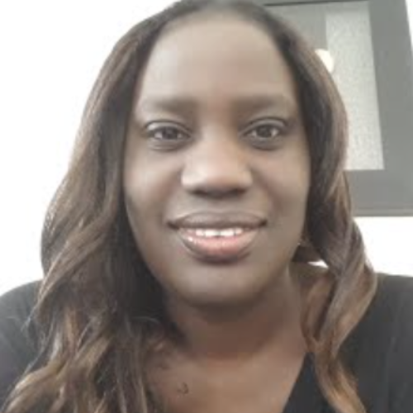
Geometric Science of Information (GSI'23) Saint-Malo, France, 30th Aug-1st Sept 2023 Keynote speaker: Diarra FALL
Statistics Methods for Medical Image Processing and Reconstruction
In this talk we will see how statistical methods, from the simplest to the most advanced ones, can be used to address various problems in medical image processing and reconstruction for different imaging modalities. Image reconstruction allows to obtain the images in question, while image processing (on the already reconstructed images) aims at extracting some information of interest. We will review several statistical methods (mainely Bayesian) to address various problems of this type.
https://gsi2023.org/
Institut Denis Poisson, UMR CNRS
Université d'Orléans
& Université de Tours, France.
M.D. Fall, N. Dobigeon, P. Auzou, "A Bayesian Estimation Formulation to Voxel-Based Lesion Symptom Mapping", Proc. European Signal Processing Conf. (EUSIPCO), Belgrade, Serbia, Sept. 2022.
3/n

Slide 6
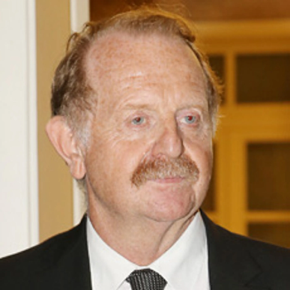

Geometric Science of Information (GSI'23) Saint-Malo, France, 30th Aug-1st Sept 2023 Keynote speaker: Hervé SABOURIN
Coadjoint Orbit Geometry & Transverse Structures
https://gsi2023.org/
Hervé SABOURIN
Poitiers University

Slide 7
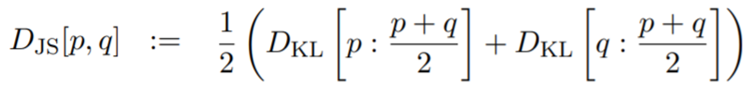
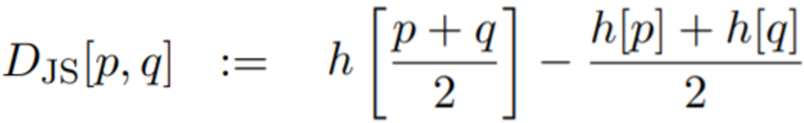
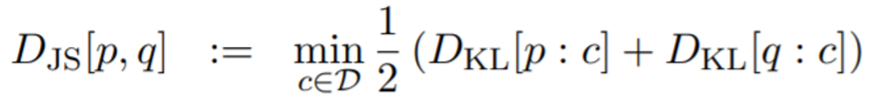
Three faces of the Jensen-Shannon divergence (JSD) ... yielding three different generalizations
JSD is a symmetrization of the Kullback-Leibler divergence:
→ Replace arithmetic mixture by geometric mixture, get geometric JSD
JSD is the entropy of the average distribution minus the average of the distribution entropies:
→ Jensen-Shannon centroid posed as a Difference of Convex program, solved using Convex-ConCave Procedure (CCCP)
JSD is Bregman information with respect to the centroid:
→ Replace arithmetic average by Rény α-means and get Sibson's α-information radius
Notes:
Three faces of the Jensen-Shannon divergence (JSD) yielding three different generalizations:
1/ Symmetrization of the KLD using means generalizing the arithmetic mixture
2/ Replacing concave Shannon entropy by other concave entropies
3/ Replacing minimization of the average KLD by minimization of other KLD means

Slide 9
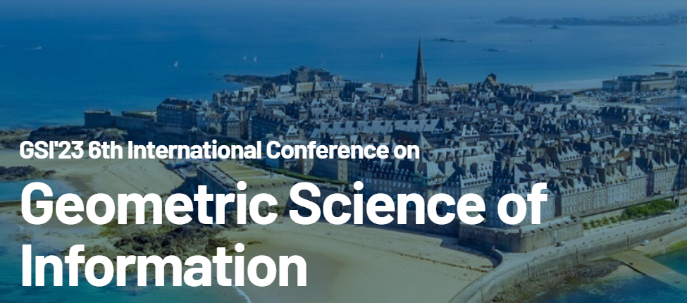
From Alan Turing to Contact geometry: towards a "Fluid computer"

